Slide 1

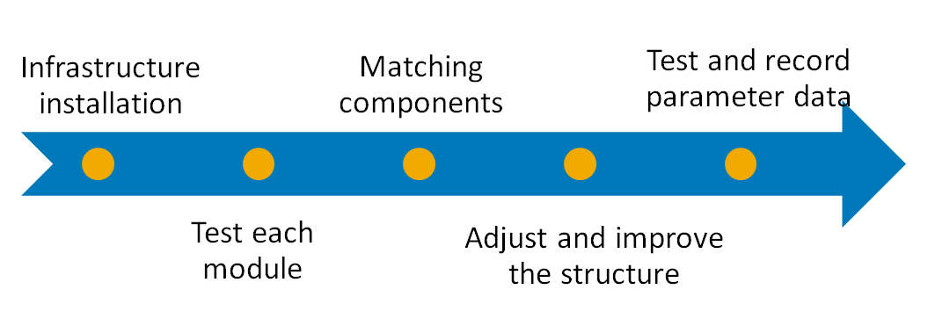
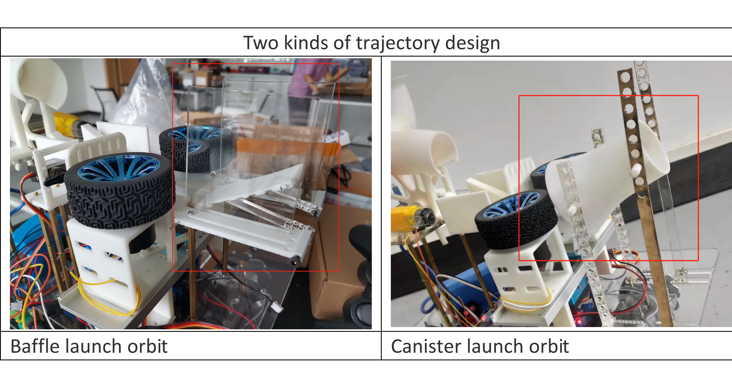
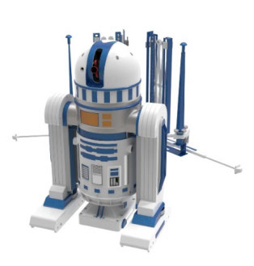
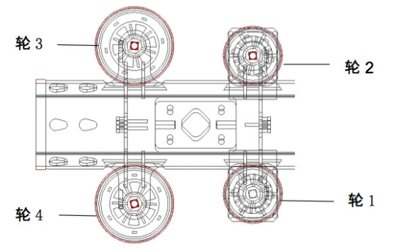
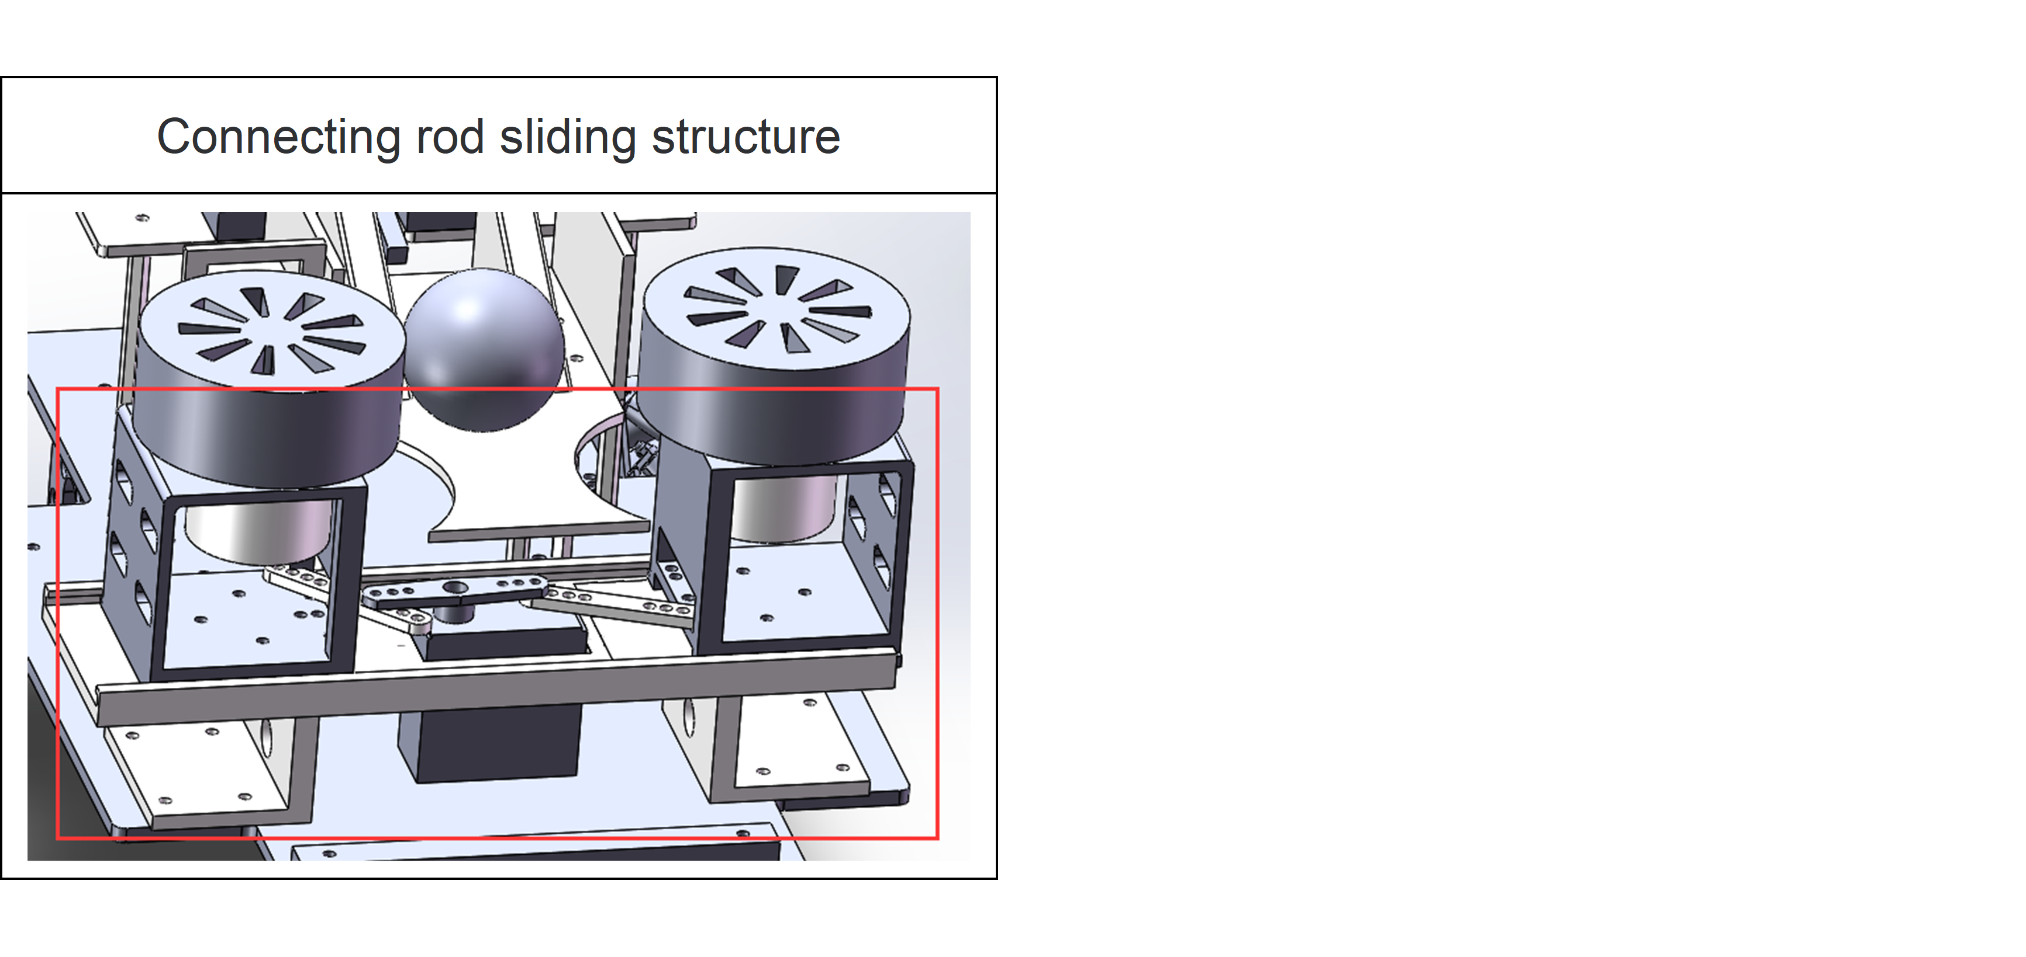
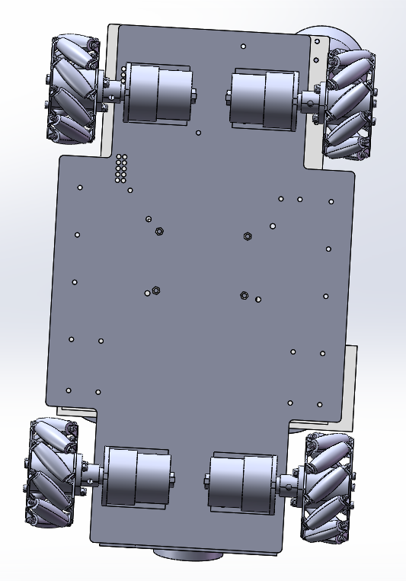
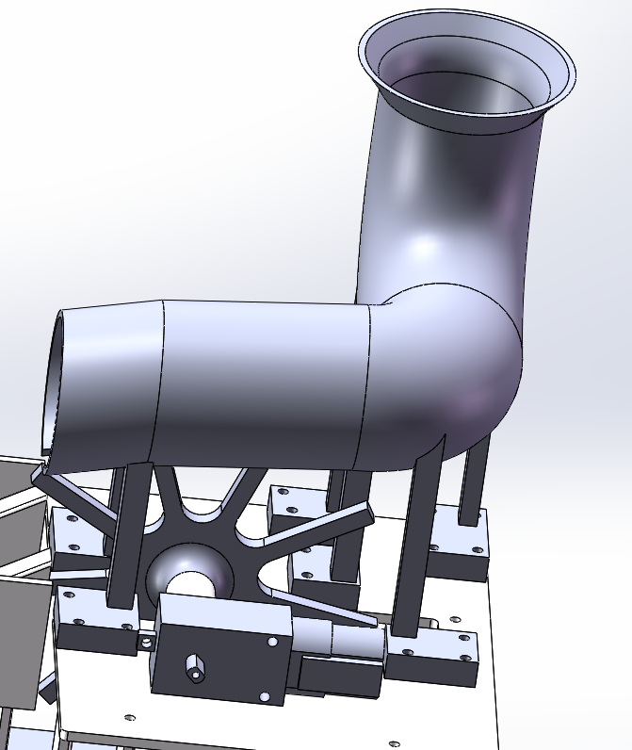
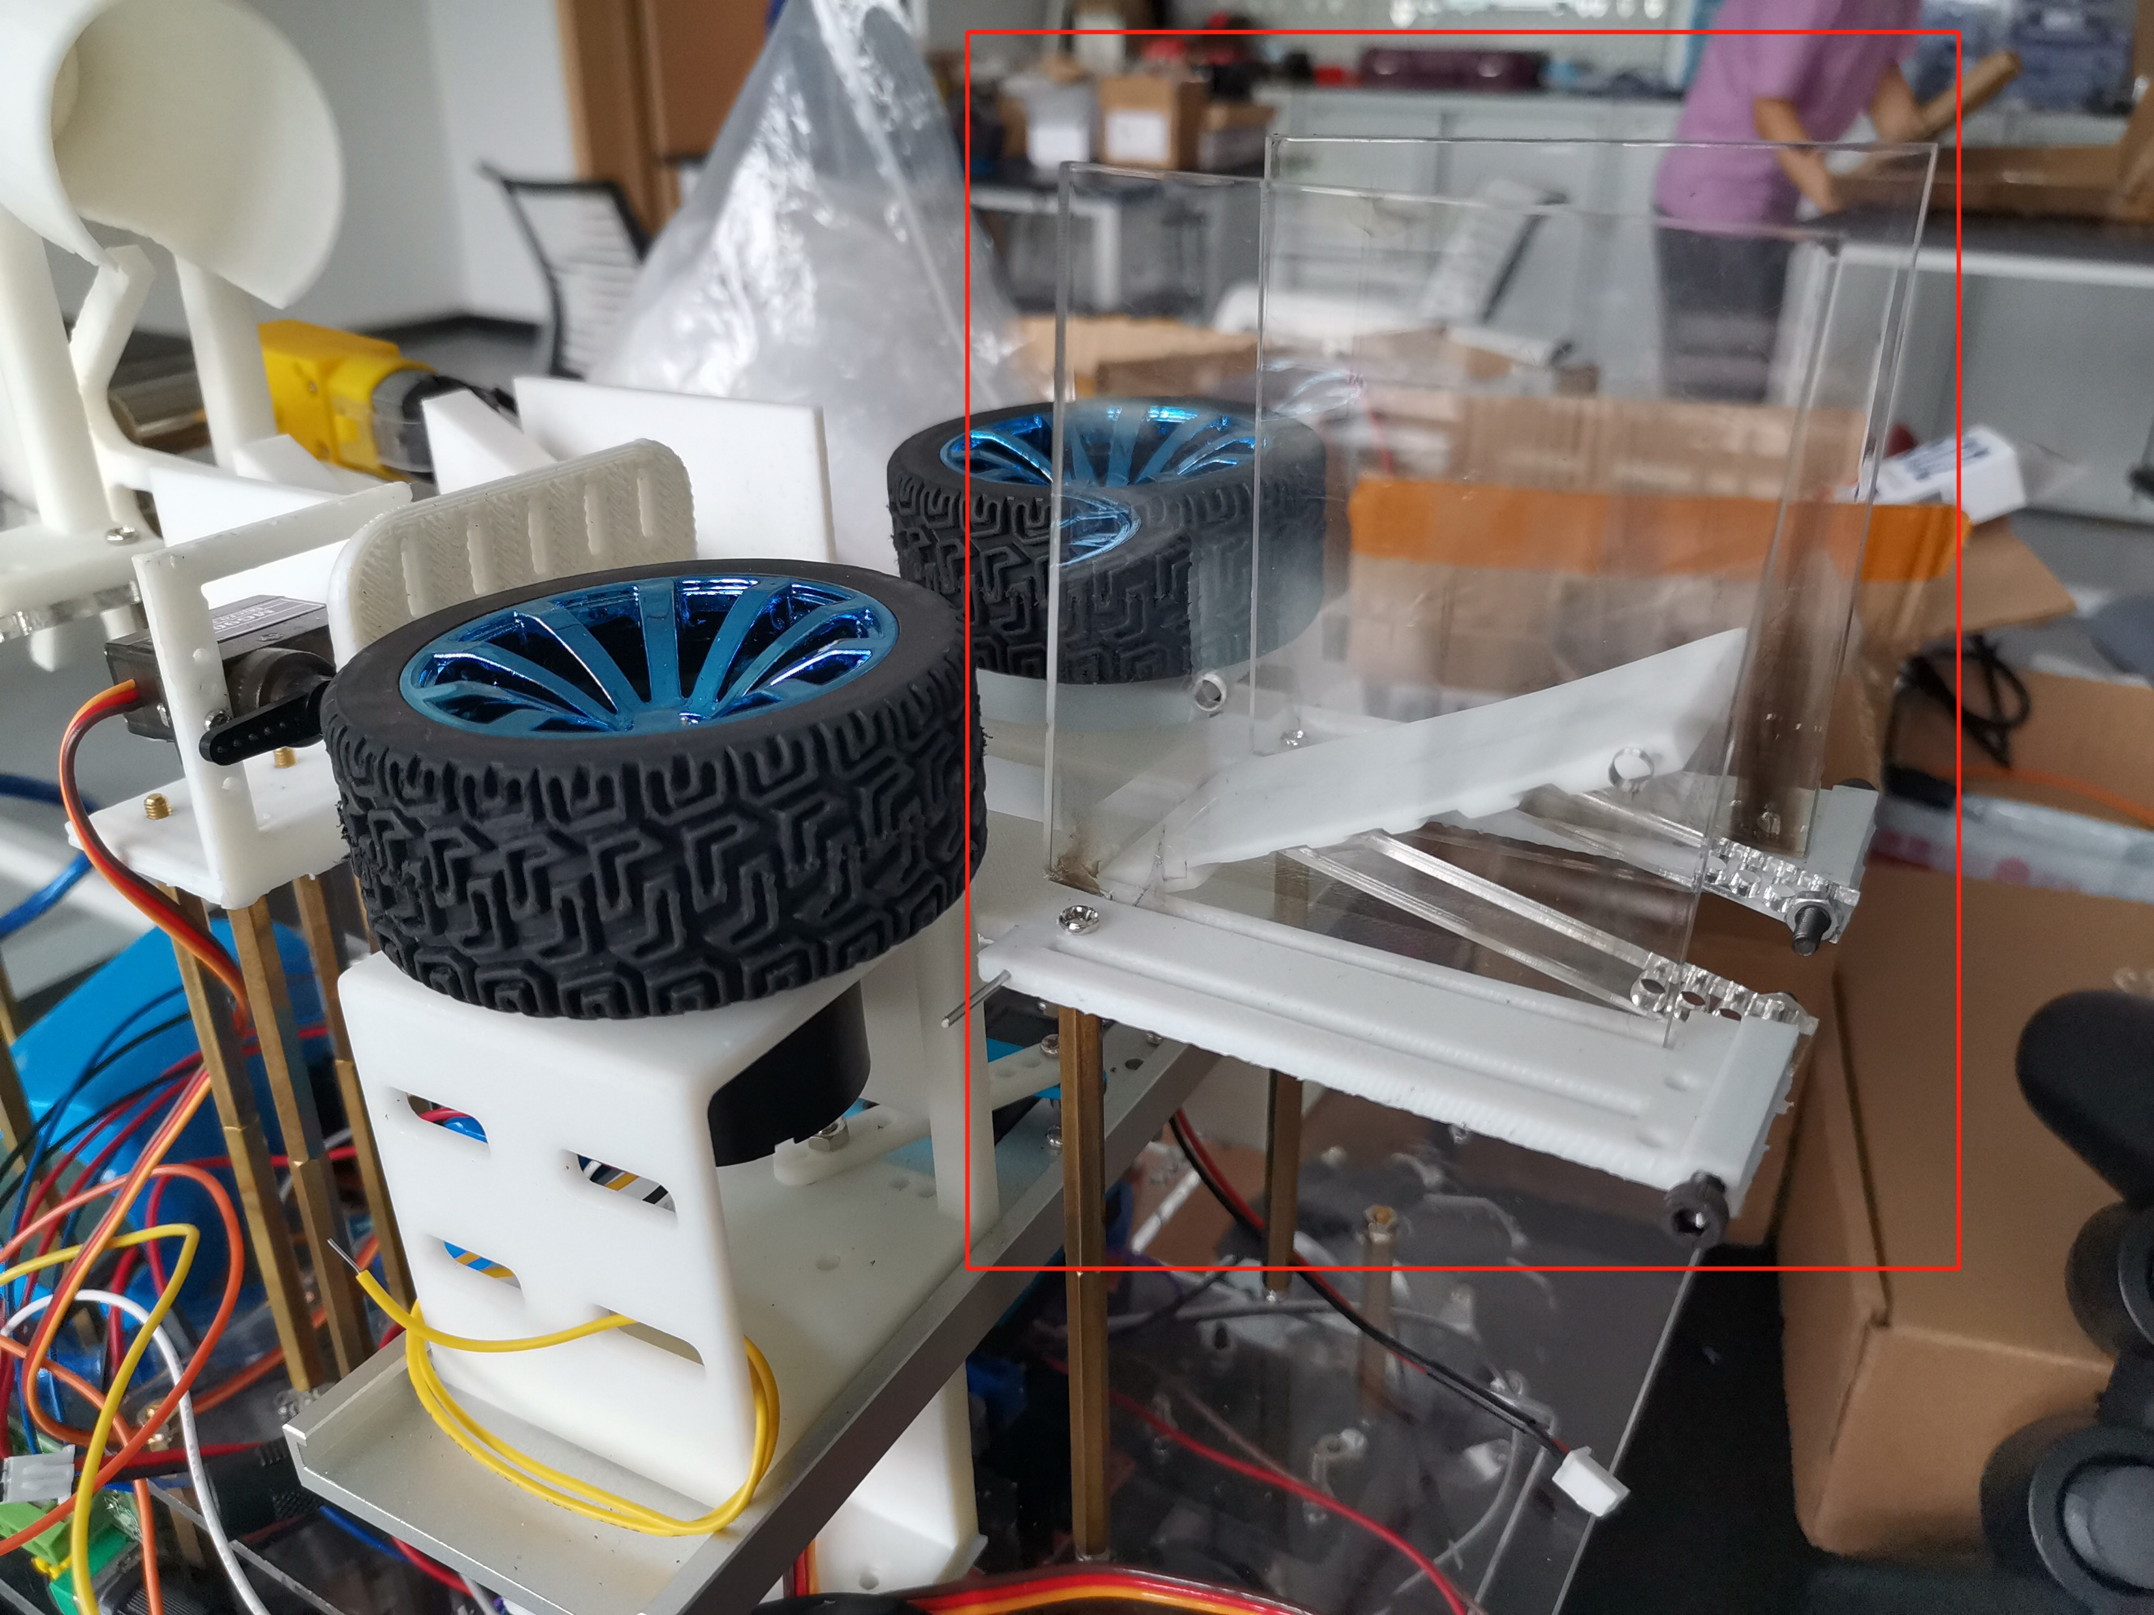
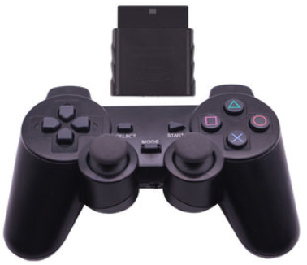
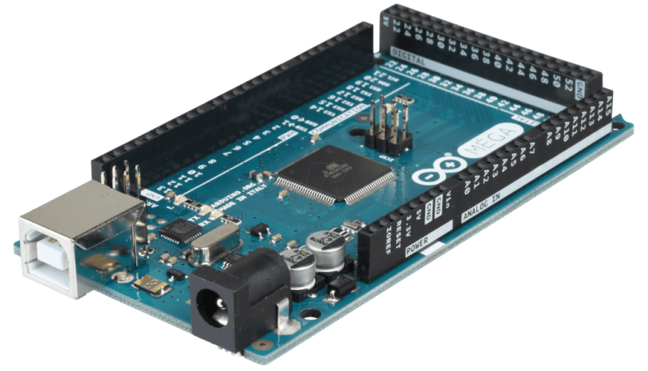
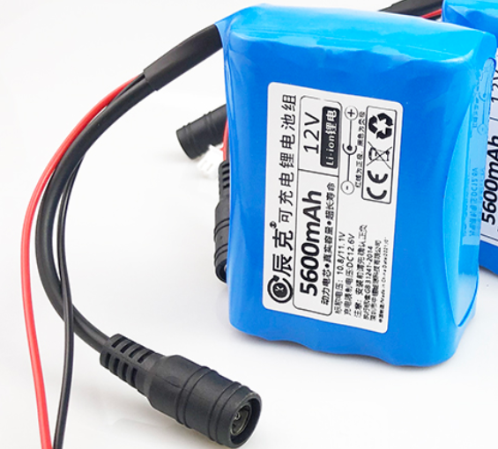
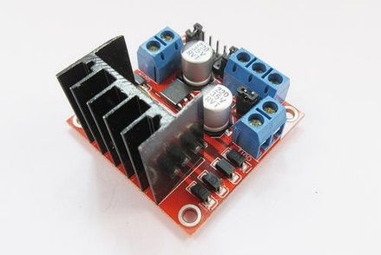
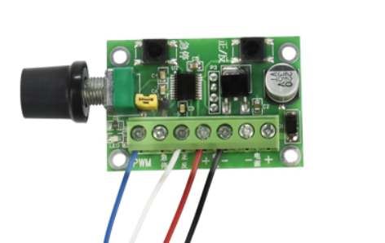
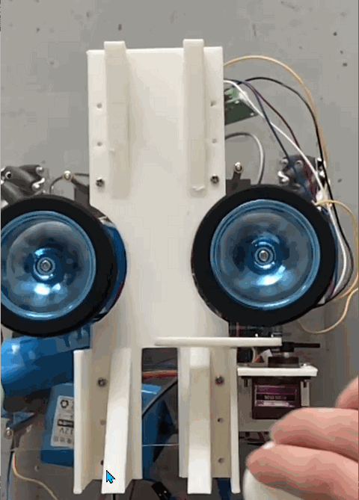
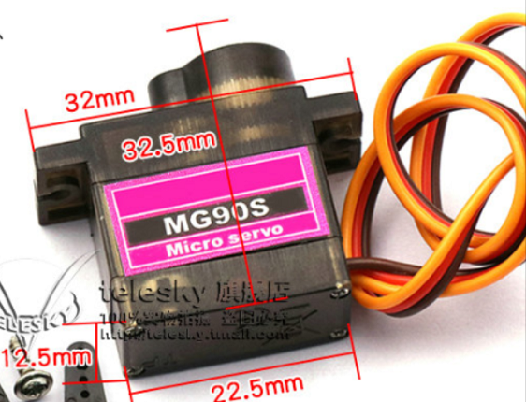
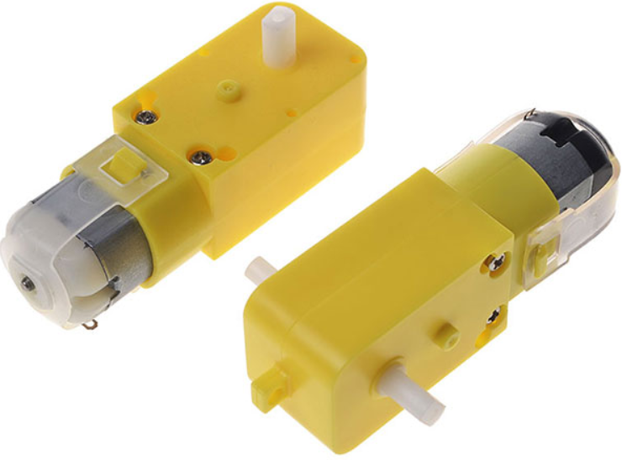
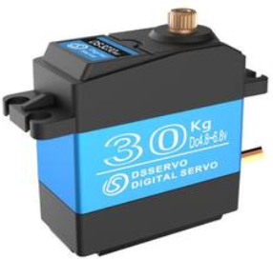
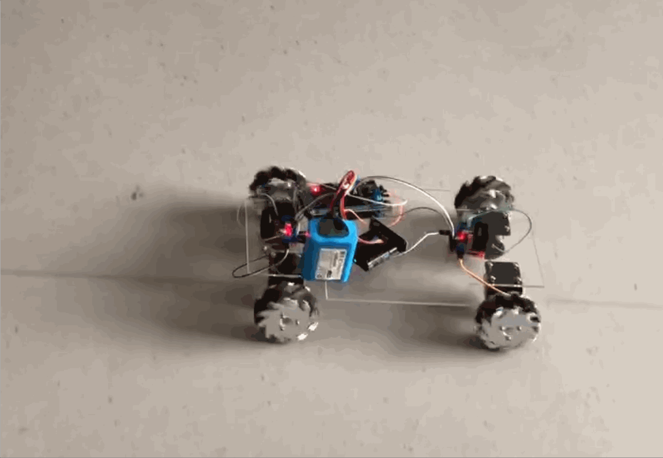
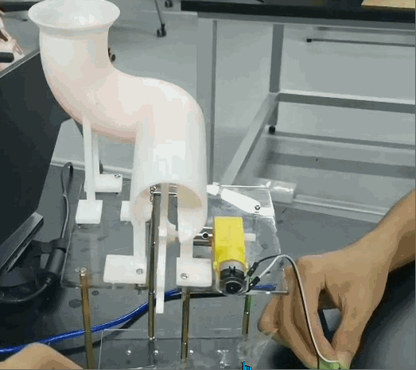
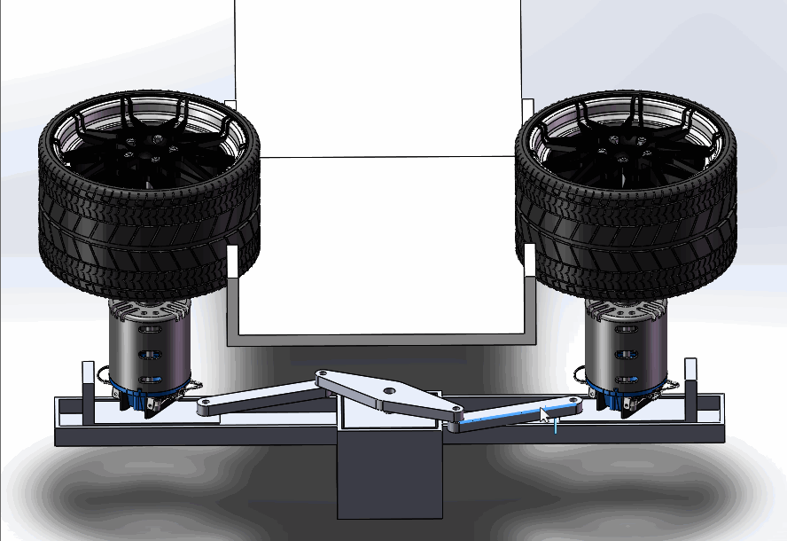
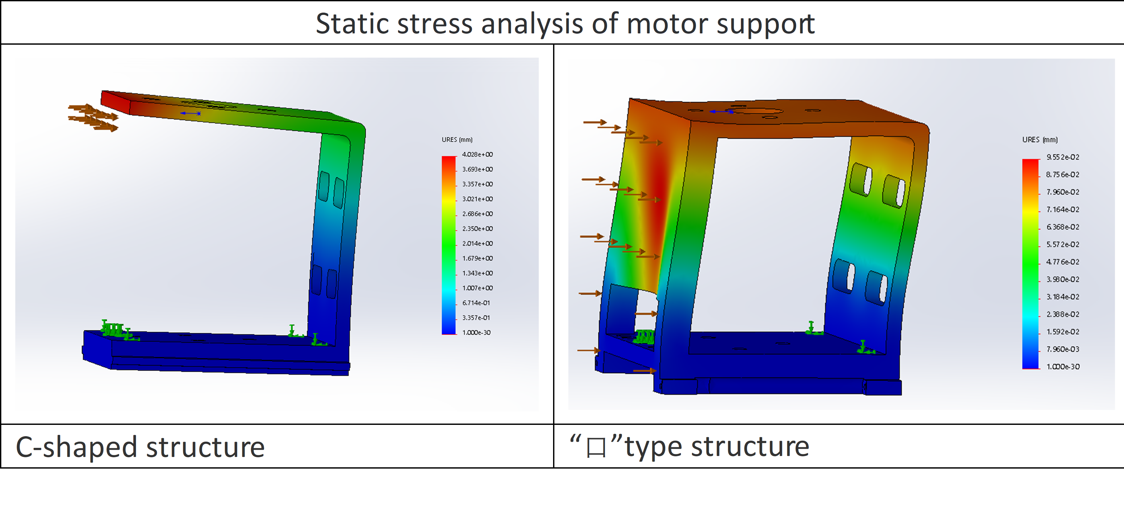
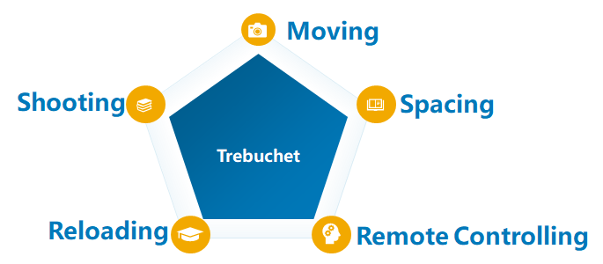
Remotely Controlled Metal Trebuchet
Team Member:
Wei Yan, Jingwen Deng, Minghui Yin, Junjie Li, Yuchen Song
Instructor: Kai Wu
Introduction
Procedure and Results
Launching direction
People in modern society pay more attention to sports activities, such as table tennis, squash and tennis. The core capability of this project is also widely used in many fields. And ball serving robot whose service machine is rubber wheel friction is similar to ours. [1] But we decided to design a more powerful robot that move quickly in any position and adapt to many types of ball launches.
Design Module | Existing Problems
Motor bracket for friction wheel | The longitudinal load force of the motor is too large, and the support is not enough.
Storing-ball pipe | The ball may be rubbed by the inner wall of the pipe and stop after rolling from the ball opening, and then it is too far from the propeller to be driven.
Trajectory | Due to possible difference between the two friction wheels, the trajectory direction of the ball maybe deviate from the center after launching.
We have two designs for the launch trajectory, as shown in the figure above. We finally choose the first as in the latter, the ball does not follow the orbit but bounces off the impact. The first performs well.
Adjust the position of friction wheels
Methodology
The middle
steering gear
is a connection.
We can drive
servo to pull the connecting rods, which aims to realize two friction wheel taxi straight movement.
Moving
Reloading
Shooting
Remote Control
Conclusions
The catapult we have designed has flexible movement, high stability and accurate shooting ability under our remote control.
Discussion and Analysis
There are mainly four functional modules in our trebuchet, as shown in the pictures above. Specifically, the mobile device applies the Mecanum wheel and the launcher applies the friction wheel mechanism.
Motor bracket
Acknowledgement
Thanks to Mr. Wu for his guidance. Thanks to TAs Dehua Gao and Jiaquan Li for their help. Thanks to the Academy for its sponsorship.
The latter increases the difficulty of assembly, but under the same shear force, the deformation generated by the shear force will be far less.
References
[1] Feng Zhongao & Zhao Lida.(2020). Design of an integrated table tennis serving robot. Design (15), 14-17. Doi: CNKI: SUN: SJTY. 0.2020-15-005.

